Slide 1
PPE PART

Slide 2
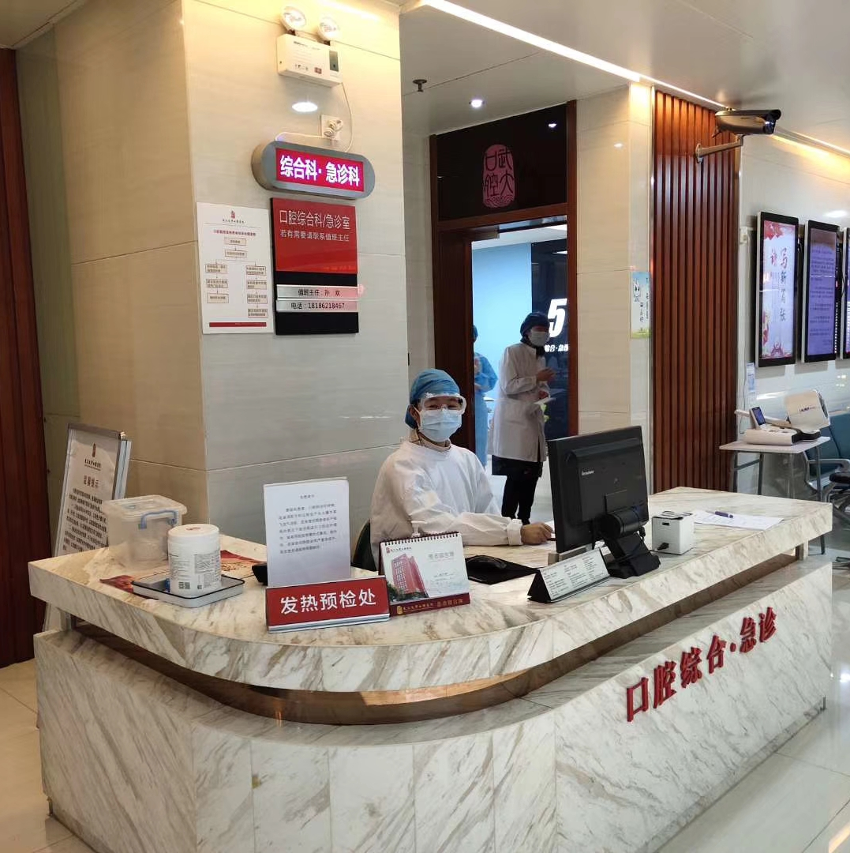
Level 1 Barriers
For people at the front desk
People should be equipped with disposable surgical masks, cap, working clothes. The gloves , goggle and face shield are optional.
For example:

Slide 3
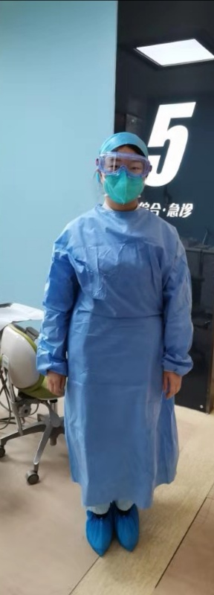
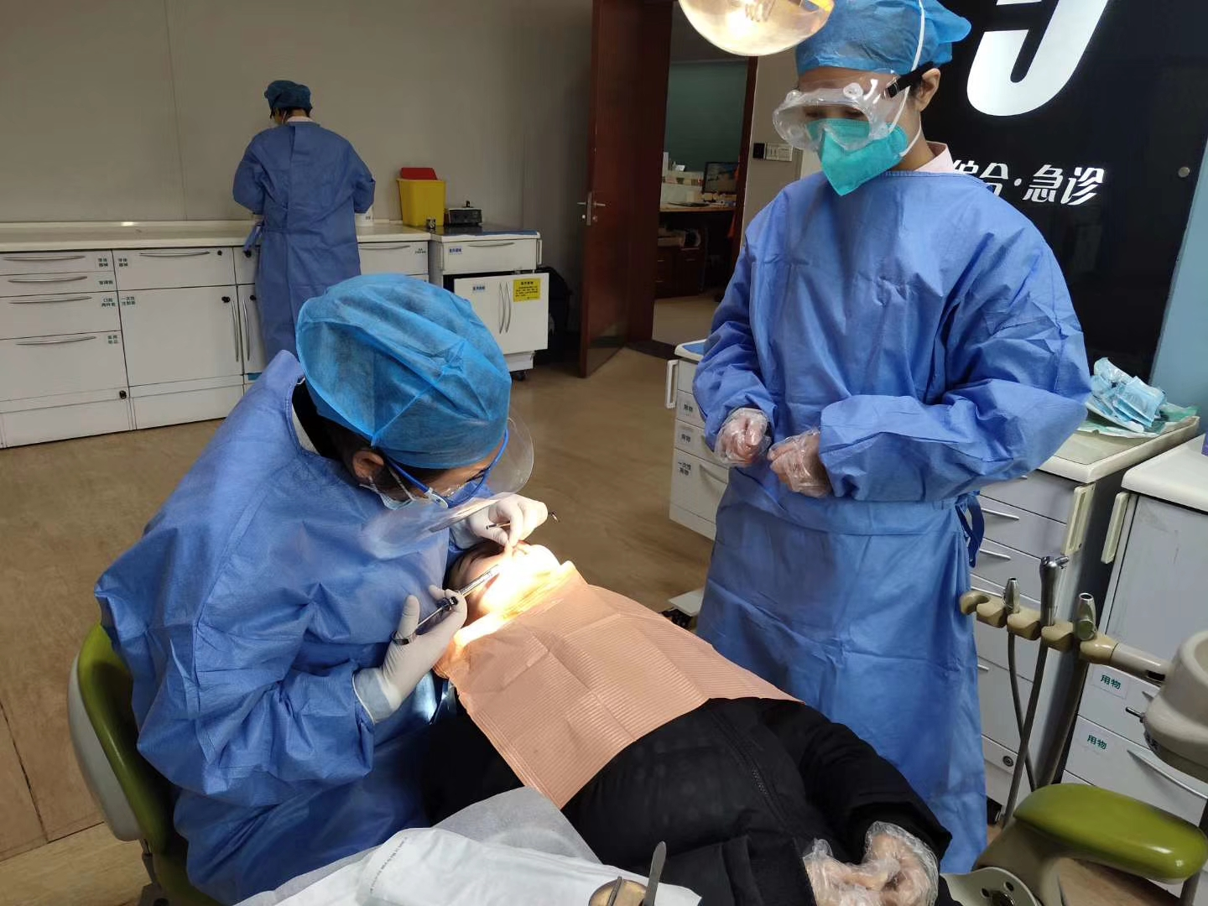
Level 2 Barriers
For people in the normal clinic to do oral examinations and dental procedures which don’t produce droplets and/or aerosols
People should be equipped with disposable N95 masks, gloves, cap, shoe cover, goggle, face shield, and gowns.
For example:

Slide 4
Level 3 Barriers
For people in the isolated clinic room where does oral examination and treat patients with fever, or who had answered “yes” to any of four questions on the questionnaire, or needing dental procedures producing droplets and/or aerosols.
The questionnaire consisted of the following four questions:
Are you a confirmed or suspected COVID-19 patient who has recovered after treatment?
Are you a confirmed or suspected COVID-19 patient with no symptoms?
Have you recently been showing COVID-19 symptoms? (optional) Such as: fever, cough, fatigue, vomiting, et cetera.
Have you been in contact with confirmed or suspected COVID-19 patients recently?

Slide 5
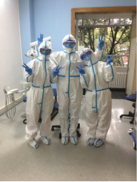
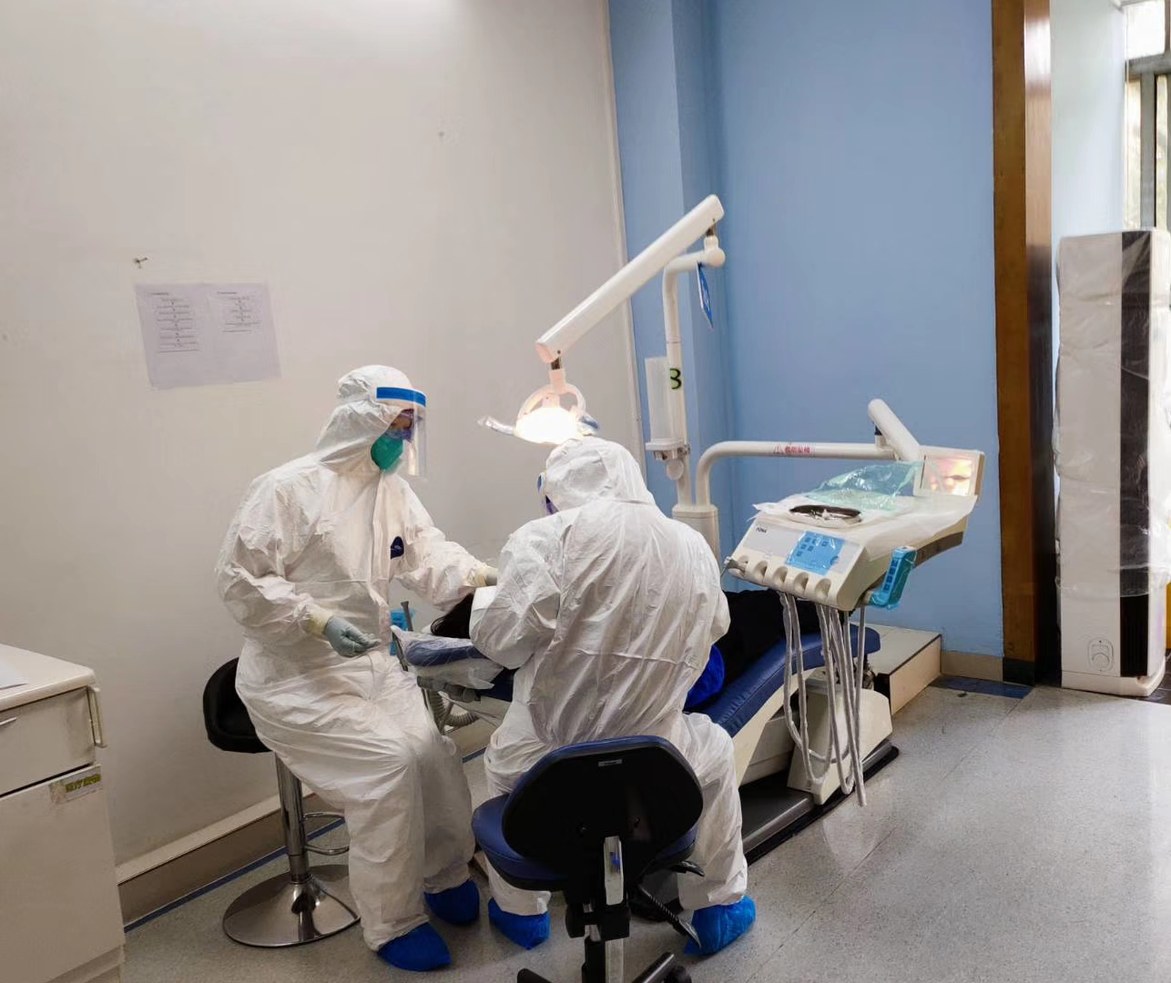
Level 3 Barriers
People should be equipped with disposable N95 masks, gloves, cap, shoe cover, , goggle, face shield, and protective suit.
For example:

Slide 6
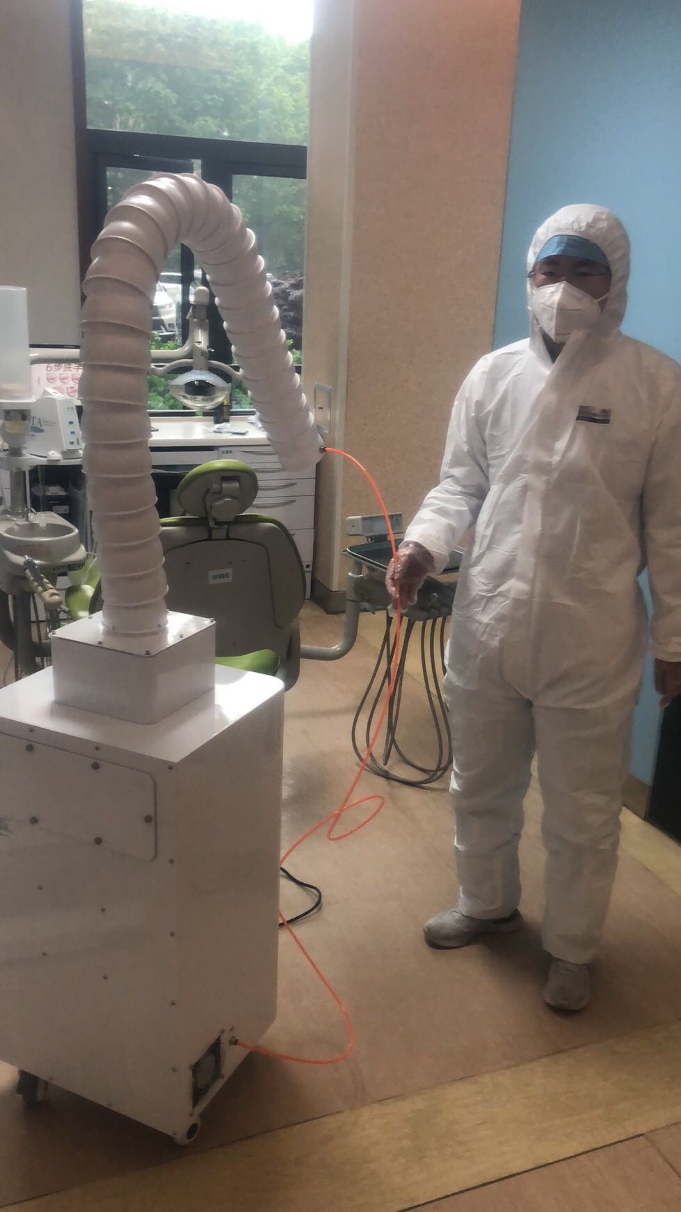
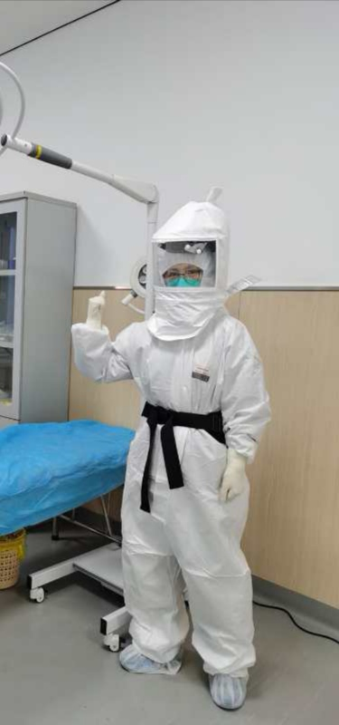
Level 3 Barriers
The aspirator to reduce the risk of droplets and/or aerosols has been used recently.
In some general hospitals where they have enough PPE resource, they will use caps which can provide positive airflow to do endodontic treatments.

Slide 7
Some tips for work and preventing infection
Divide clean area and polluted area in the clinic
Divide Entry and Exit for patients and Entry and Exit for health workers
Divide rest room for patients and Entry and rest room for health workers

Slide 8
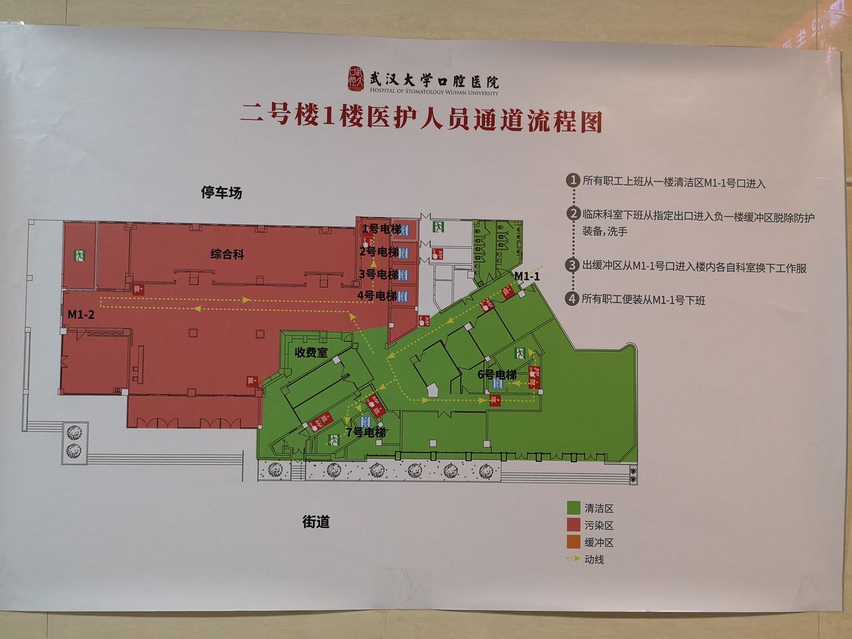
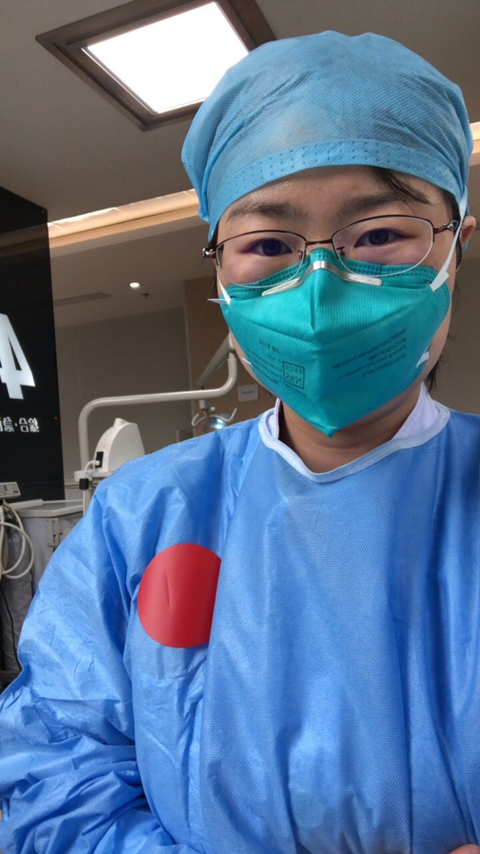
Some tips for work and preventing infection
Green area are clean area and Red area are
People in polluted area have red stickers on gowns to remind them not to enter clean area with polluted PPE.

Slide 9
Some tips for work and preventing infection
Goggles are very important to prevent COV-19 infection. However, it’s very easy to get fog which prevents us to see clear, even 3M brand. To prevent the goggles from fogging up, we usually use liquid soap to wipe the inner and outer faces of the goggle without washing, then we use dry paper tissue to wipe the faces again; if it’s still easy to have fog, on this basis, we will use iodophor to wipe the faces of goggles, and clean the iodophor with dry paper tissue again, it will work. Or you can choose to use iodophor spay on the faces of the goggles, and let it dry naturally, it can also prevent fogging up.

Slide 10
Clinic setting and disinfection part

Slide 11
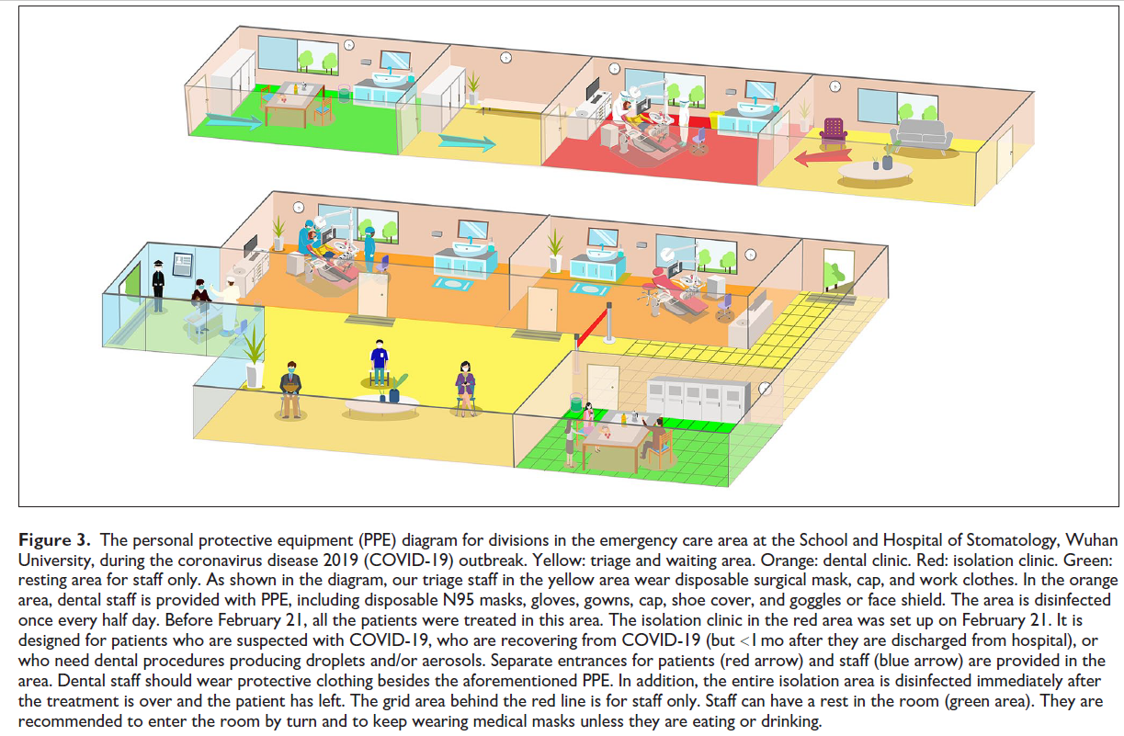
The setting of normal clinic and isolate clinic
Isolate clinic
Normal clinic

Slide 12
Cleaning rules of normal clinic
A. Air disinfection
Open the window to keep the air fresh.
If there is no people in the clinic, ultraviolet lamps are used for disinfection, twice a day, 60 minutes each time. Start recording time after the light is on for 5 minutes.
Use air disinfectant machine to do air disinfection. Recommend to open it one hour before work, and two hours after work. Four times a day, 2 hours each time. Operate according to the instruction.

Slide 13
Cleaning rules of normal clinic
B. Environment disinfection
The object surface of the clinic should be wiped with 500g/L chlorine-containing disinfectant at least three times a day. The floor of the clinic should be cleaned with 500g/L chlorine-containing disinfectant first, 30 minutes later, the floor should be cleaned with clear water again, at least three times a day. Pay more attention to the taps, doorknob and things which people touch frequently, if polluted, disinfect immediately.
The restroom should be cleaned with 2000g/L chlorine-containing disinfectant twice a day. If polluted, disinfect immediately.

Slide 14
Cleaning rules of isolate clinic
A. Air disinfection
Open the window to keep the air fresh, at least 2-3 times a day, 30 minutes every time.
Use air disinfectant machine to do air disinfection, four times a day, 2 hours each time. Operate according to the instruction.

Slide 15
Cleaning rules of isolate clinic
B. Environment disinfection
The object surface of the table, chair, window, cabinet, door, doorknob, and floor should be cleaned with 1000g/L chlorine-containing disinfectant, twice a day. The floor should be wet cleaned.
All surface of dental chair should be covered with isolating membrane. The places where isolating membrane could not be covered, use disinfectant wet wipes.
If anywhere is polluted by patients’ secretions or vomit, use hygroscopic material to remove the pollution which you can see, then cover the place with 2000g/L chlorine-containing disinfectant for 30 minutes, then wipe the places again.
Suction and spittoon of the dental chair should be flashed with 2000g/L chlorine-containing disinfectant after every patient.
Cleaning and disinfecting tools in different areas should be separated

Slide 16
Cleaning rules of isolate clinic
C. Goods management
Stethoscope, sphygmomanometer, thermometer should be wiped with 75% alcohol or disinfectant wet wipes immediately after use.
Instruments needing recycle are putted into 1000g/L chlorine-containing disinfectant for 30 minutes immediately after use, and then transferred to recycle containers with covering. Instruments which are not resistant to corrosion, are disinfected with 2% glutaraldehyde for 30 minutes first, then sealed with double blue bags, marked with “Special infected material”, and transferred to sterilization center as soon as possible. Goggle and face shield are putted in special container which has 1000g/L chlorine-containing disinfectant for 30 minutes, then cleaned and dried. The recycle containers are disinfected with 1000g/L chlorine-containing disinfectant for 30 minutes after use, then flushed and dried.

Slide 17
Cleaning rules of isolate clinic
D. Garbage management
The garbage of COV-19 confirmed or suspected patients should be recognized as infected rubbish, sealed with double yellow bag, marked with “Special infected material” and transferred to garbage room immediately.
All kinds of garbage should be transferred out the clinic within 24 hours.

Slide 18
Keep safe and healthy!

